Slide 1
Data Engineering Module 3
Kerry Nakayama

Slide 2
What is Snowflake?
” Snowflake is a data warehouse built on top of the Amazon Web Services or Microsoft Azure cloud infrastructure. There’s no hardware or software to select, install, configure, or manage, so it’s ideal for organizations that don’t want to dedicate resources for setup, maintenance, and support of in-house servers.”
--Snowflake Handbook

Slide 3
Why Snowflake?
Has anyone ever set up a MYSQL, POSTGRESQL, MSSQL, ORACLE or other data warehouse instance?
What are some of the issues that you had to face?
What are some of the hardships?
How do you handle demand changes ?
How do you handle high query demands?

Slide 4
Traditional Enterprise Data Warehouse Architecture
So if we were to jump into the “way back machine” we would find that initial data warehouses were single-server and tightly coupled machines.
Storage of data, computation of data, and services were all held on a single machine
This leads to a myriad of problems, including:
Possible data loss
Concurrency issues
WHAT IF THE SERVER BREAKS?!?

Slide 5
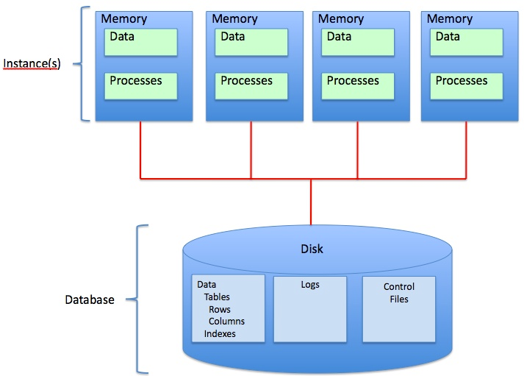
Shared Disk Servers
Notes:
The shared-disk architecture was the first approach to emerge for scaling beyond the single-node SMP architectures of early systems.
It is designed to scale processing beyond a single server while keeping data in a central location.
In a shared-disk system, all of the data is stored on a storage device that is accessible from all of the nodes in the database cluster.
Any change in the data is updated and reflected in the single storage location.
Shared-disk architectures are attractive for their simplicity of data management:
all processing nodes in the database cluster have direct access to all data, and that data is consistent because all modifications to the data are written to the shared disk

Slide 6
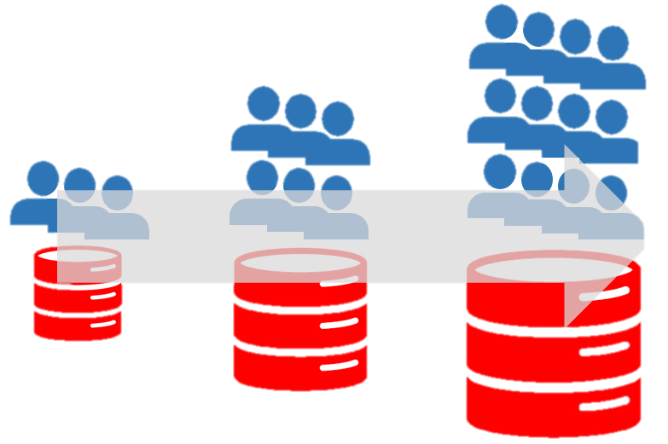
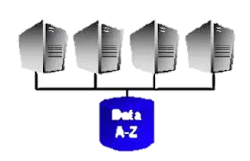
Shared Disk Servers
What are the issues?
So why not just add more?
Scalability
Notes:
scalability of this architecture is severely limited
Even small number of concurrent queries will overwhelm the storage device and the network to it,
forcing processing major slow downs for data to be returned from the shared disk.
Additional compute nodes only exacerbate the overloaded shared disk.
Further, complicated on-disk locking mechanisms are needed to ensure data consistency across the cluster.

Slide 7
Shared Nothing
To avoid these issues, Snowflake uses something known as a “SHARED NOTHING” architecture.
Notes:
The shared-nothing architecture scales processing and compute together by distributing different subsets of data across all of the processing nodes in the system,
This eliminates the bottleneck of communication with a shared disk

Slide 8
Shared Nothing
From Wikipedia:
“A shared-nothing architecture (SN) is a distributed computing architecture in which each node is independent and self-sufficient, and there is no single point of contention across the system. More specifically, none of the nodes share memory or disk storage.”

Slide 9
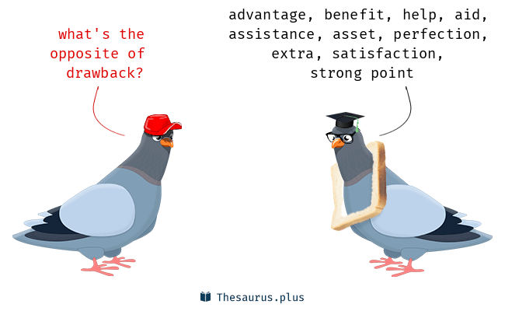
Shared Nothing Drawbacks
Drawbacks
Data is distributed across multiple nodes
Requires shuffling of data between nodes
Adds overhead and reduces performance
Data is distributed when loaded
User specified distribution key
Default algorithm
Node Failure
Changing distribution requires completely redistributing data across the cluster
Heterogenous workload and Homogenous hardware
If heavy compute it will need low IO and vise versa
Hardware being homogenous does not allow this
Software upgrades are done across all nodes which cause issues
Notes:
Drawbacks
When you SCALE the cluster and add more nodes …What happens to all the data?
- the data is distributed across the cluster and requires shuffling of data between nodes.
- This adds overhead and reduces performance
Distribution of data across compute nodes is done through static assignment-
Data is distributed at the time it is loaded
- user specified distribution key
- default algorithm
Node Failure
- Changing the data distribution typically requires completely redistributing data across the cluster or even unloading and reloading data
Heterogenous workload and Homogenous hardware
- Heavy compute needs a low IO but the coupled homogenous hardware does not allow this
- also causes issues with upgrades and membership changes

Slide 10

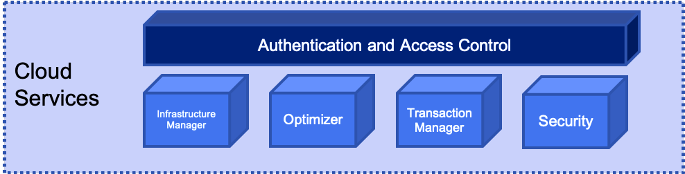
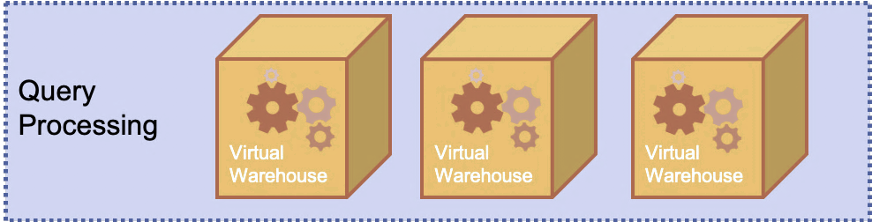
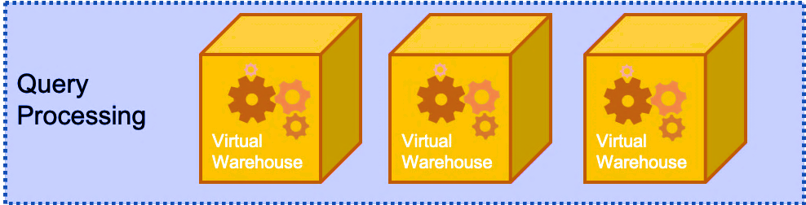
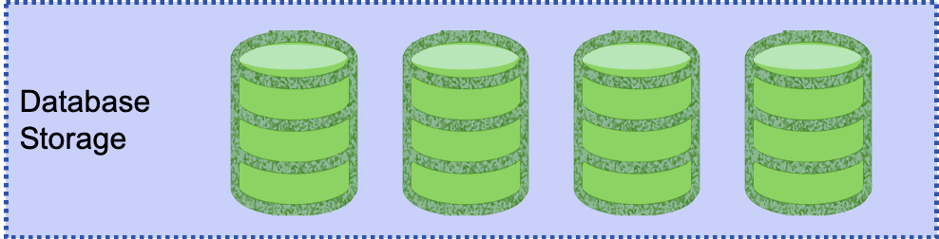
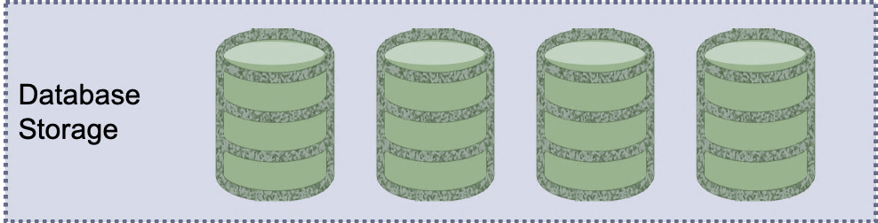
Snowflake is a hybrid of Shared Nothing and Disk
So how does Snowflake address these shortcomings?
Snowflake is Elastic!
Notes:
The idea here is that by using the cloud based infrastructure SNOWFLAKE can essentially throw resources at the management of shared-nothing infrastructure indefinitely.
This is because Snowflake is elastic in nature- it will expand as resources are required and contract when not required.
This addresses both the high compute requirements of Shared Nothing AND the high-cost requirements of creating “workers”

Slide 11
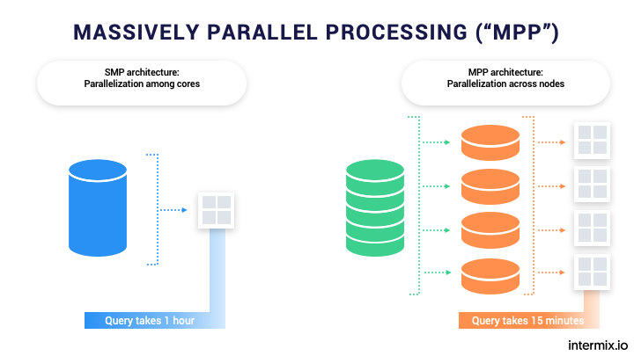
Massive Parallel Processing
Snowflake is a shared-nothing or massive parallel processing system.
Imagine if you will, for a minute, a series of workers, each of whom have their own memory, resources, and processors assigned to a task.
We can split the task among these workers thereby speeding up the task immeasurably.
“MPP is the coordinated processing of a program by multiple processors that work on different parts of the program, with each processor using its own operating system and memory”

Slide 12
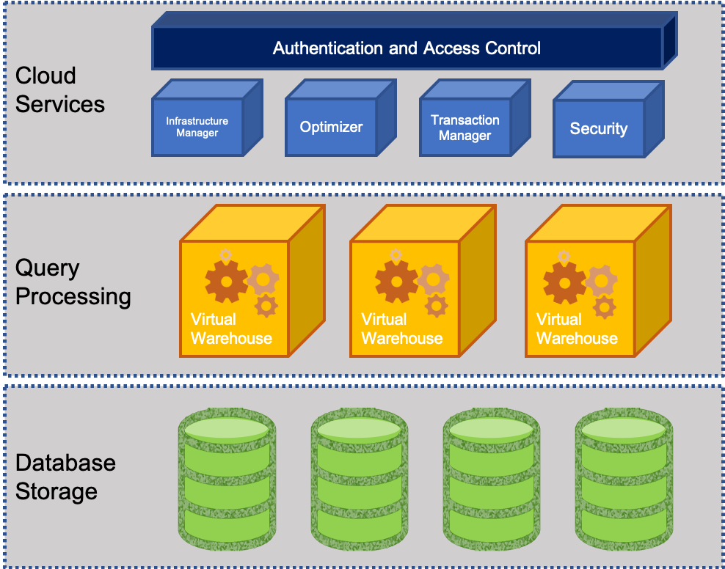
What does Snowflake offer?
Let’s divide data warehouses into three parts:
Storage: for storing data and
Computing: which is what allows us to do all the things we do in structured SQL databases
Services: Which are some of the things like pipelines, etc.
Snowflake offers us the opportunity to independently scale the storage, services, and the computing. Why is this important?

Slide 13
Snowflake: Why this design?
In a traditional data warehouse, storage, compute, and database services are tightly coupled.
This can stem from either the configuration of the physical nodes (even in the cloud), or the architecture of the data warehouse appliance. Even “big data” platforms tie storage, compute and services tightly together within the same nodes.
Big data platforms can scale compute and storage to some degree, but they still suffer from the same predictable performance limitations as the number of workloads and users increase.

Slide 14
Snowflake Intro
“Snowflake is a single integrated solution with completely independent scaling for compute, storage and services. Unlike shared-storage architectures that bundle storage and compute together, Snowflake enables instant, automatic scaling of storage, analytics, or workgroup resources for any job at any time.”
-- Snowflake handbook

Slide 15
Efficient data storage in Snowflake Database Storage Layer
The storage layer contains tables, schemas, databases, and diverse data
If managed well storage layer can hold petabytes of data
Snowflake has scalable cloud blob storage type for storing structured and semi-structured data
Such as JSON, AVRO, and Parquet
Snowflake optimizes the metadata for easy extraction and query processing
Storage is made up of multiple micro partitions that are encrypted and scale automatically
Allows for efficient data retrieval and performance
Notes:
Should be a review from previous days

Slide 16
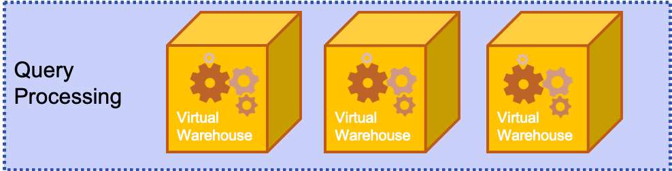
Efficient data storage in Snowflake Query Processing Layer
This layer contains virtual warehouses where all the queries are run on each respective virtual warehouse
Allows for a scalable compute capacity
Each Virtual warehouse gets data from the storage layer and has it cached to the compute resources
Multiple VW operate simultaneously to maintain ACID and follow multiple parallel processing
ACID (Atomic, Consistent, Isolated and Durable) that ensure a database management system (DBMS) will make changes to data in a reliable
VW can auto-suspend, auto-resume, and have auto-scaling that can be built in
Notes:
Should be a review from previous days

Slide 17
Efficient data storage in Snowflake Cloud Services Layer
This layer is the cerebrum of Snowflake where it maintains, optimizes, transacts on data, as well as provides security, and metadata management
Enables SQL client interface for DDL and DML like operations on data
VW can auto-suspend, auto-resume, and have auto-scaling that can be built in
Authentication
Infrastructure management
Metadata management
Query parsing and optimization
Access control
Notes:
Should be a review from previous days

Slide 18
Snowflake Architecture

Slide 19
Snowflake Elasticity
The idea behind the design and architecture of Snowflake was always that it would be built completely on the cloud and 100% cloud native.
It needs to be elastic- able to expand and contract in accordance with demand.
It needs to be fully managed. YOU (the user) should not be utilizing DBAs to provision and manage more and more servers for your demand; snowflake is designed to take all of that off your plate.
It needs to have native support for various data types. We need it to be able to understand JSON, AVRO, XML, etc. without the clunky utilization of poorly built and sourced plugins.

Slide 20
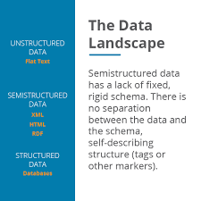
Snowflake Data Types
Snowflake offers native ingestion of various data types that other data warehouses don’t.
Have any of you ever been in a scenario where you needed to load, say, an XML or a multi-dimensional JSON into a structured SQL database?
How did you have to manipulate that data?
How much work did it take to get it in there?
Did you have to flatten it first?
The makers of snowflake felt your pain here and offer the VARIANT data type.

Slide 21
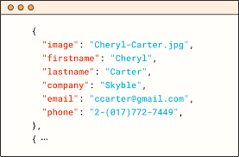
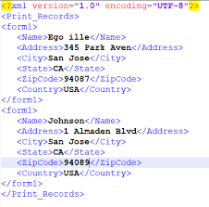
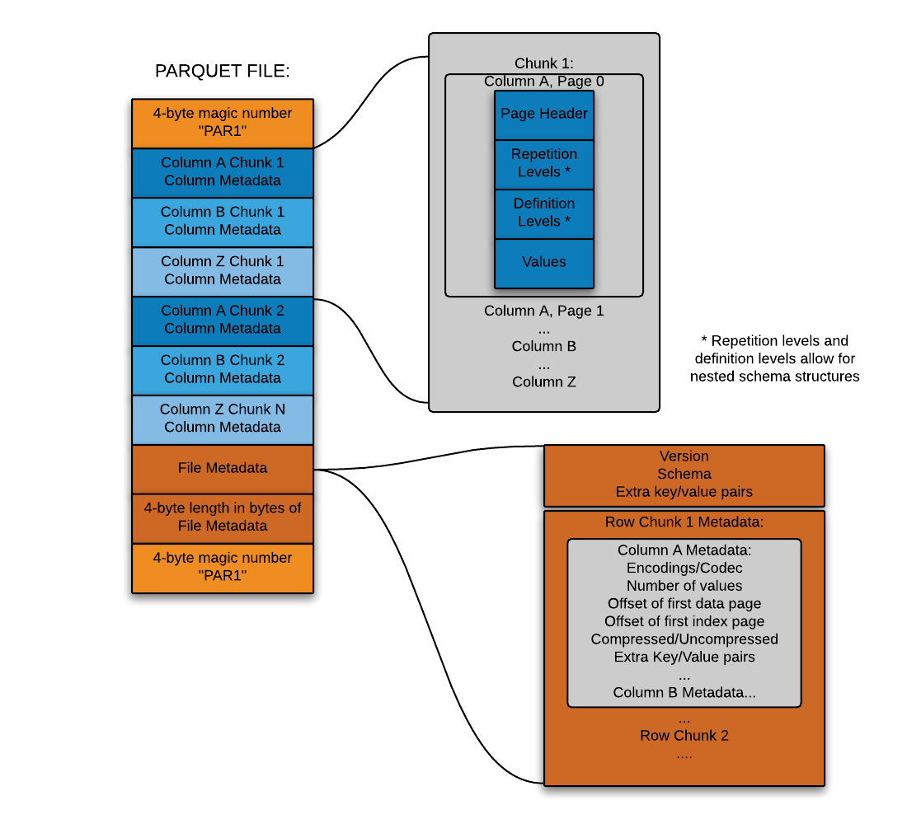
Snowflake data types
Snowflake started by making it possible to flexibly store semi-structured records inside a relational table in native form
This is accomplished through a custom datatype (Snowflake’s VARIANT datatype) that allows schema-less storage of hierarchical data, including JSON, Avro, XML and Parquet
This makes it possible to load semi-structured data directly into Snowflake without pre-processing, losing information, or defining a schema
You simply create a table containing a column with Snowflake’s VARIANT datatype and then load files containing semi-structured data into that table.
JSON
Avro
XML
Parquet

Slide 22
Snowflake Variant data types
When Snowflake loads semi-structured data, it automatically discovers the attributes and structure that exist in the data to optimize how it’s stored.
It looks for repeated attributes across records, and then organizes and stores those repeated attributes separately, enabling better compression and fast access similar to the way that a columnar database optimizes column storage
Statistics about these pseudo-columns are also calculated and stored in Snowflake’s metadata repository for use in optimizing queries

Slide 23

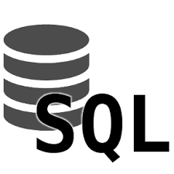


Snowflake Data Types
So why is this an advantage?
Have any of you had to deal with working with a SQL and NOSQL database side by side?
Maybe HADOOP for some data and POSTGRESQL for other data?
The idea behind Snowflake is that it’s a one-stop-shop where you can store and process all this data in one place.

Slide 24
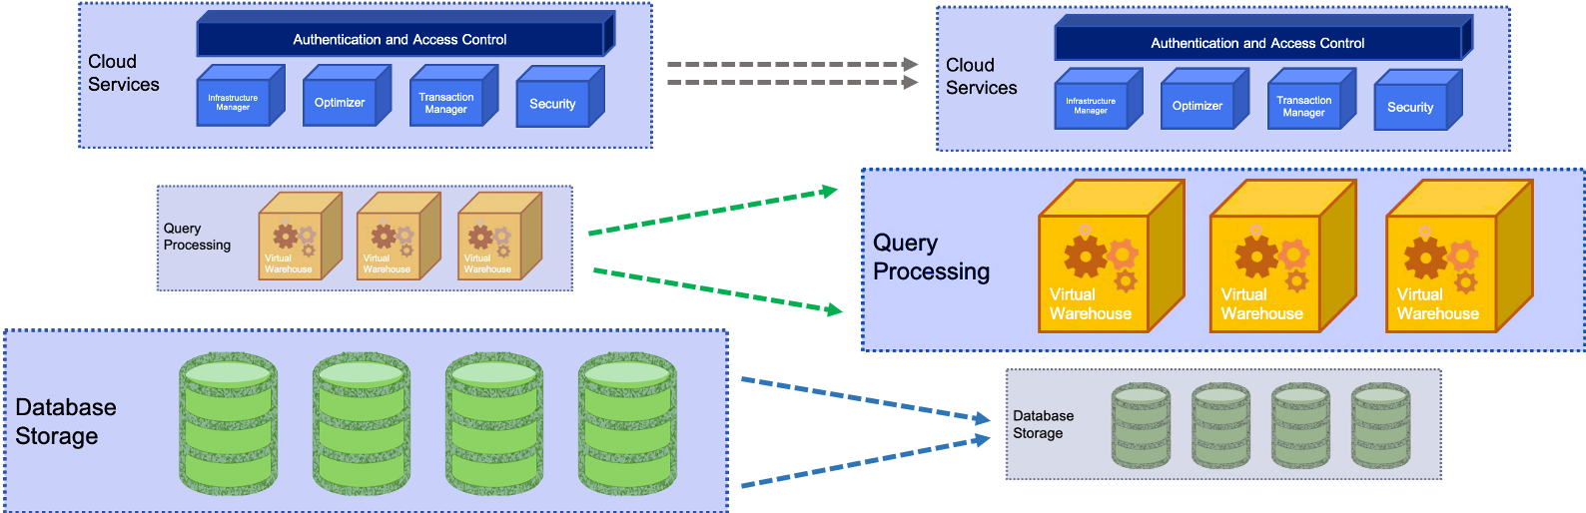
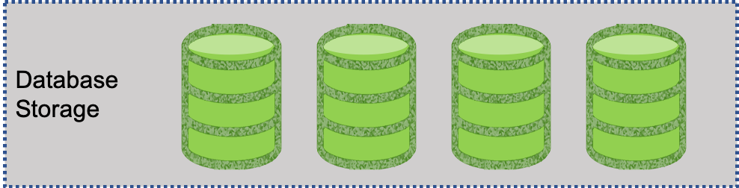
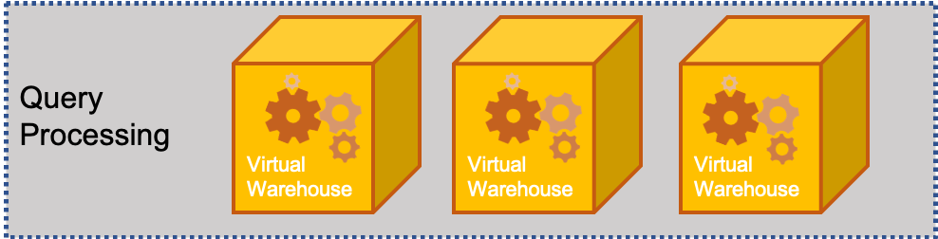
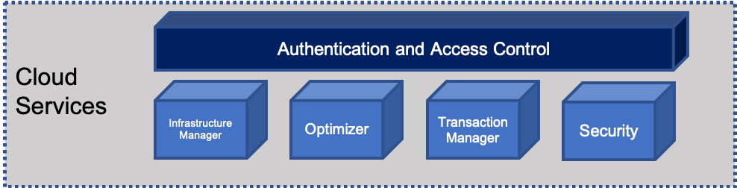
Snowflake Elasticity
Snowflake has a novel concept to deal with elasticity:
This means that we can deal with the DATA STORAGE, COMPUTE and USERS (Services) layer without effecting the other ones
DATA
Services
Compute
Notes:
By isolating each layer they can expand and contract independently of each other.
This means that we can deal with the DATA STORAGE, COMPUTE and USERS (Services) layer without effecting the other ones.
Let’s go into each of these
DATA - The amount of data stored can be increased or decreased at any time.
- Data and compute decoupled – is determined independently of the volume of data in the system
- store data at a very low cost because no compute resources are required to store data in the database
COMPUTE – these resources that are being used for query processing can also be scaled up or down depending on the intensity of the workload on the system changes.
- remember - storage and compute are decoupled,
- data is dynamically distributed
- changing compute resources does not require reshuffling the data
- Compute resources can be changed on-the-fly, without disruption.
SERVICES – with other systems as more users come on the the resources are strained and everything becomes much slower
- other system solution is to create a new datamart
- extra management burden
- replicating and/or migrating data across systems
- Snowflake can scale to support more users and workloads without performance impact because multiple virtual warehouses can be deployed on-demand, all with access to the same data.

Slide 25
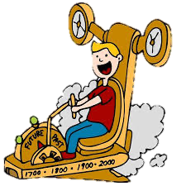

Snowflake Automation
So now let’s talk about a lot of the “under the hood” things that Snowflake can do for us, including:
Time Travel:
Enables you to immediately revert any table, database or schema to a previous state. It’s enabled automatically and stores data as it’s transformed for up to 24 hours, or 90 days in enterprise versions.
Copying to clone:
Most data warehouses require you to copy data to clone, forcing a large amount of manual effort and a significant time investment.
Snowflake’s multi-cluster, shared data architecture ensures that you never need to copy any data, because any warehouse or database automatically references the same centralized data store

Slide 26

Snowflake Automation
Data distribution:
Managed automatically by Snowflake based on usage.
Snowflake automatically manages how data is distributed in the virtual warehouse
Other systems rely on a static partitioning scheme based on a distribution algorithm or key chosen by the user at load time
Data is automatically redistributed based on usage to minimize data shuffling and maximize performance.
Loading Data:
Complex ETL data pipelines are no longer needed to prepare data for loading. Snowflake natively supports and optimizes diverse data, both structured and semi-structured, while making that data accessible via SQL.

Slide 27
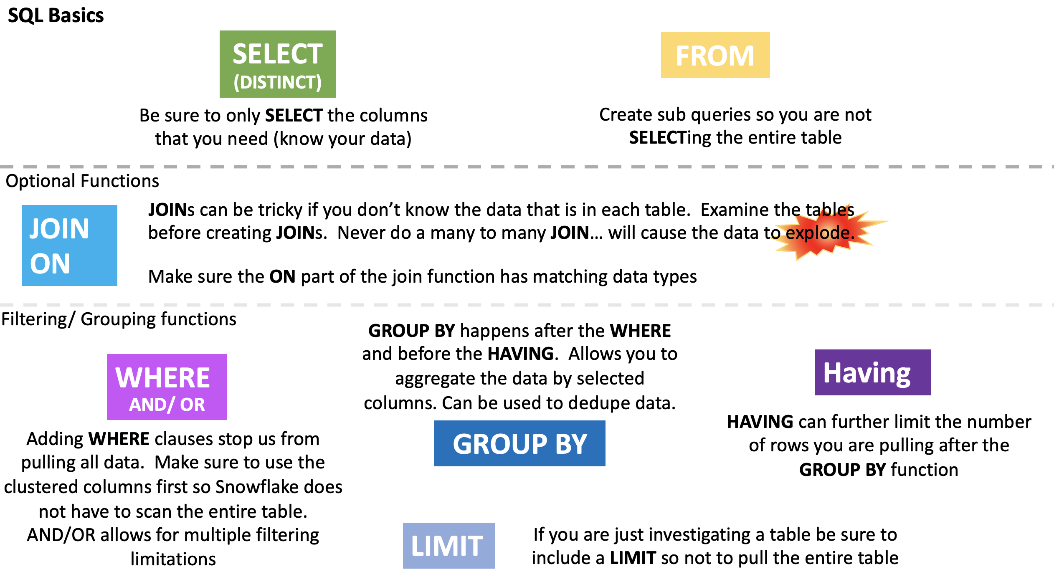
Snowflake Automation
Dynamic query optimization:
Ensures that Snowflake operates as efficiently as possible by looking at the state of the system when a query is dispatched for execution,
Looks at it multiple times – not just when it is compiled
USE THE SQL THAT YOU ALREADY KNOW
Rather than dealing with NOSQL and the like you can use SQL that your team is already familiar with to create dynamic, powerful, fast moving queries.

Slide 28
Confused? ASK QUESTIONS

